Slide 1


Rameses II
The Pharaoh Who Made
a Name for Himself
(1279-1213 BCE)
Shared by Lin Donn
Illustrated by Phillip Martin

Slide 2

Rameses II
Each time a new pharaoh came to power, each neighboring civilization sent an army or two to test the new pharaoh.
The neighbors hoped that perhaps this time they could steal a piece of Egypt for themselves.

Slide 3
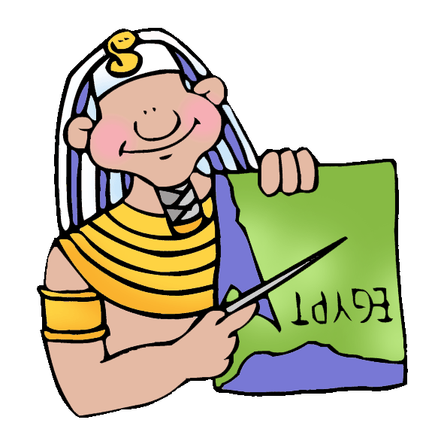
Rameses II
When Rameses II became pharaoh, the neighbors sent warriors to see what would
happen. Rameses II was a brave man, a good husband, and a loving father. But he was a terrible general.
Some people remember him today because he was such a poor general. Luckily, he had great helpers.

Slide 4
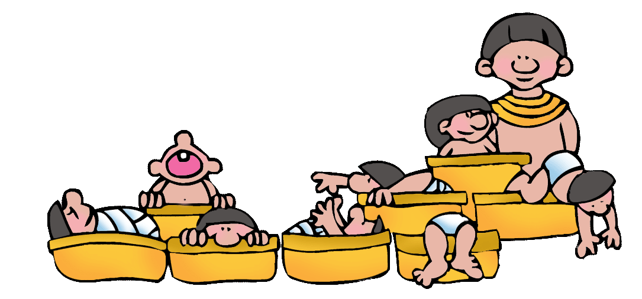
Rameses II
Some remember Rameses as the Pharaoh who had 111 sons, 51 daughters, and many wives. Others recognize his name because he ordered
the construction of the temple of Abu Simbel, the huge temple that is 180 feet long, 90 feet high, and decorated with four 60 foot high statues of
Rameses II.

Slide 5
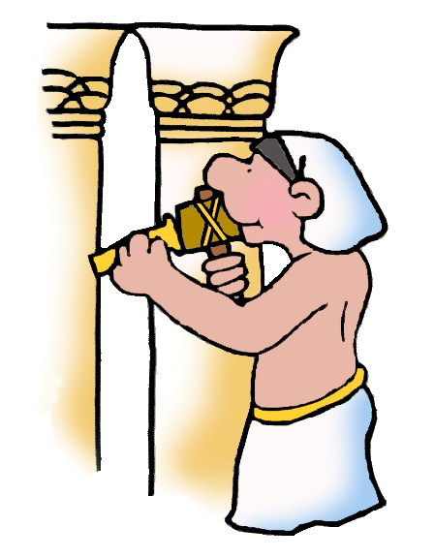
Rameses II
But in ancient Egypt, people knew his name because Rameses ordered his name chiseled on everything.
He even had his name put on statues that were not statues of himself. He did this to bolster people’s confidence in his leadership abilities.

Slide 6
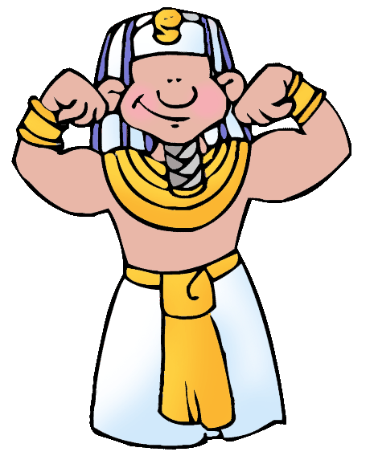
Rameses II
Today, his name is still found in Egypt on ancient buildings. But it was not
his chiseling that kept Egypt safe. Egypt was strong enough to survive his 60-year rule. Egypt was an ancient world power.
Her reputation, supported by capable leaders in the military, kept Egypt safe.

Slide 7
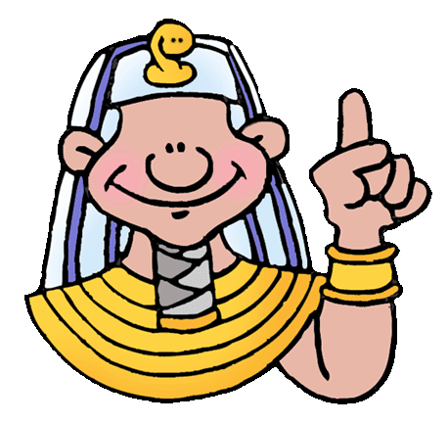
Quiz Question
Name one reason people remember Rameses II.

Slide 8
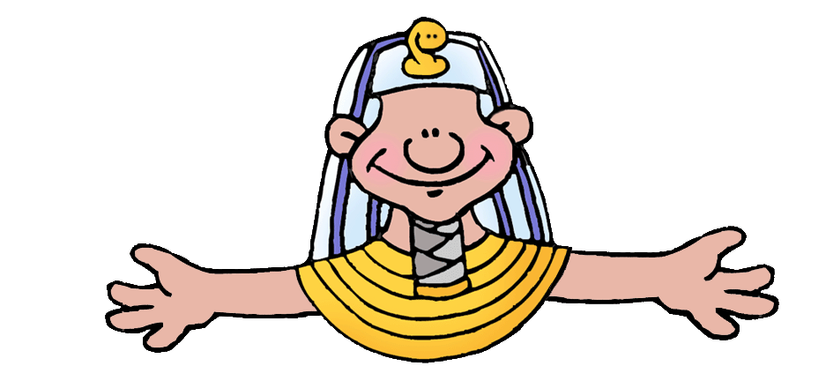
Quiz Answer
He was a lousy general
He had a a lot of kids
He chiseled his name all over Egypt
He built a huge temple

Slide 9
To Learn More
Go Here:
Ancient Egypt for Kids

Slide 10
Clip Art/Templates
Created by a professional and published artist, Phillip Martin, go here to find:
Free Ancient Egypt Clip Art
Free Templates & How to Use Them

Slide 11
Presentations
Free Presentations in PowerPoint format written by us
To see some of the other neat things we’ve written and illustrated, go here:
We’re Published!

Slide 12
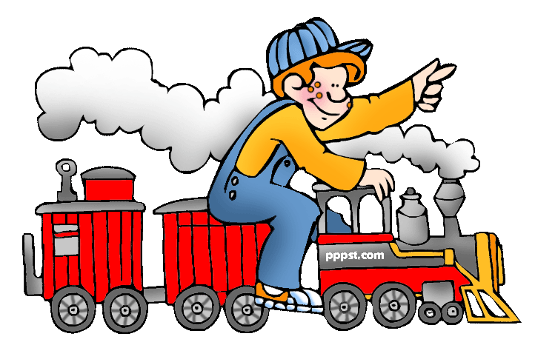
Explore …
PPPST.COM

